Slide 1
Journal Club Slides
Jordan Gulli
Prepared 10/8/2018
PhD Candidate
Georgia Institute of Technology

Slide 2
Snowflake yeast
Video courtesy of Pedro Marquez
Cells DNA Cell Wall

Slide 3
Notes:
The title of this talk has tipped my hand: yes, simple multicellularity can evolve quickly.

Slide 4
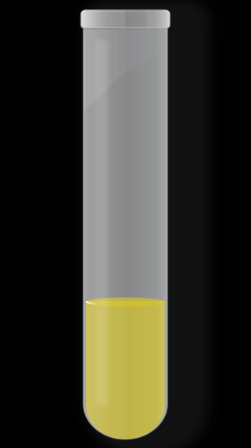
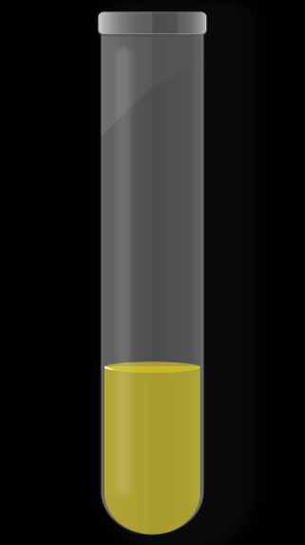
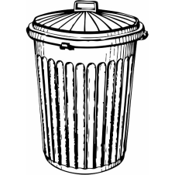
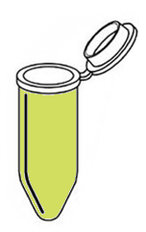
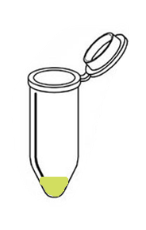
Selection for settling speed
24 hour, shaking
incubation
Wait 5
minutes
Discard upper
90% of media
Transfer to fresh
media

Slide 5
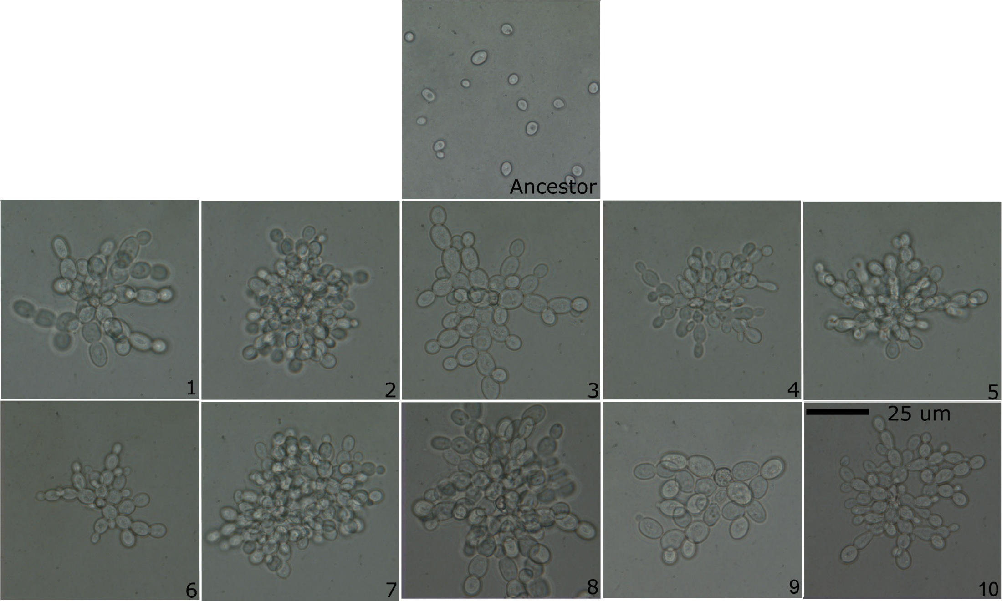
Evolution of multicellularity
Ratcliff, W. C., R. F. Denison, M. Borrello and M. Travisano (2012). "Experimental evolution of multicellularity." Proceedings of the National Academy of Sciences 109(5): 1595-1600.

Slide 6
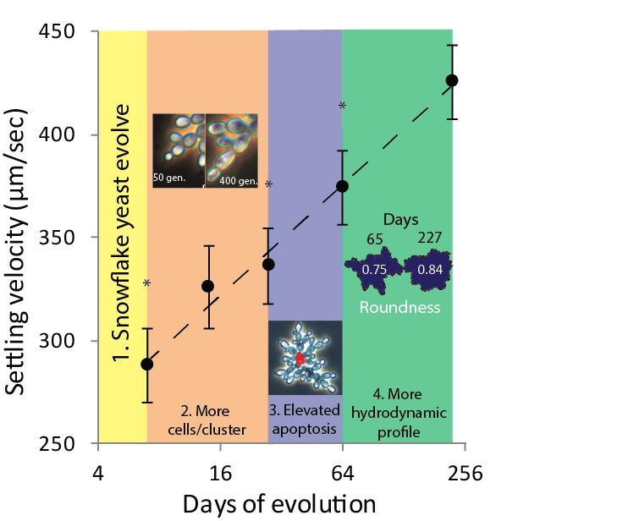
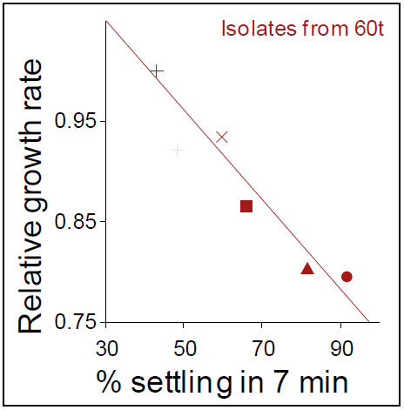
Evolution of novel traits in snowflake yeast
Ratcliff, W. C. and M. Travisano (2014). "Experimental Evolution of Multicellular Complexity in Saccharomyces cerevisiae." BioScience 64(5): 383-393. Ratcliff, W. C., R. F. Denison, M. Borrello and M. Travisano (2012). "Experimental evolution of multicellularity." Proceedings of the National Academy of Sciences 109(5): 1595-1600.

Slide 7
Research question
What happens when snowflake yeast clusters are put under intense selection for settling speed?

Slide 8
Selection for extremely rapid settling
5 minutes
24 hour, shaking
incubation
Wait 60
seconds
Discard upper
90% of media
Transfer to fresh
media
1 minute

Slide 9
Experimental predictions
Hypothesis 1
100 µm
100 µm
Hypothesis 2
100 µm

Slide 10
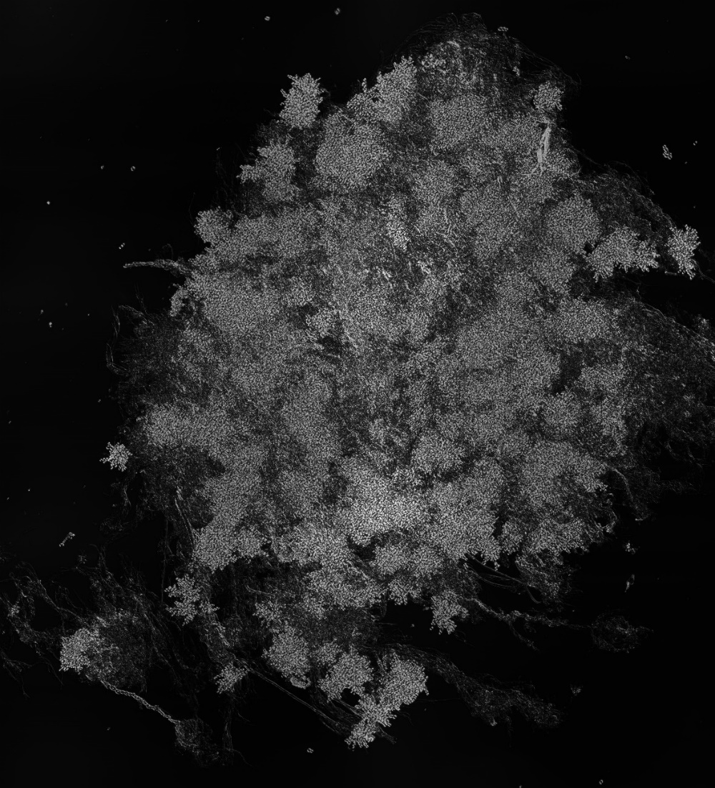
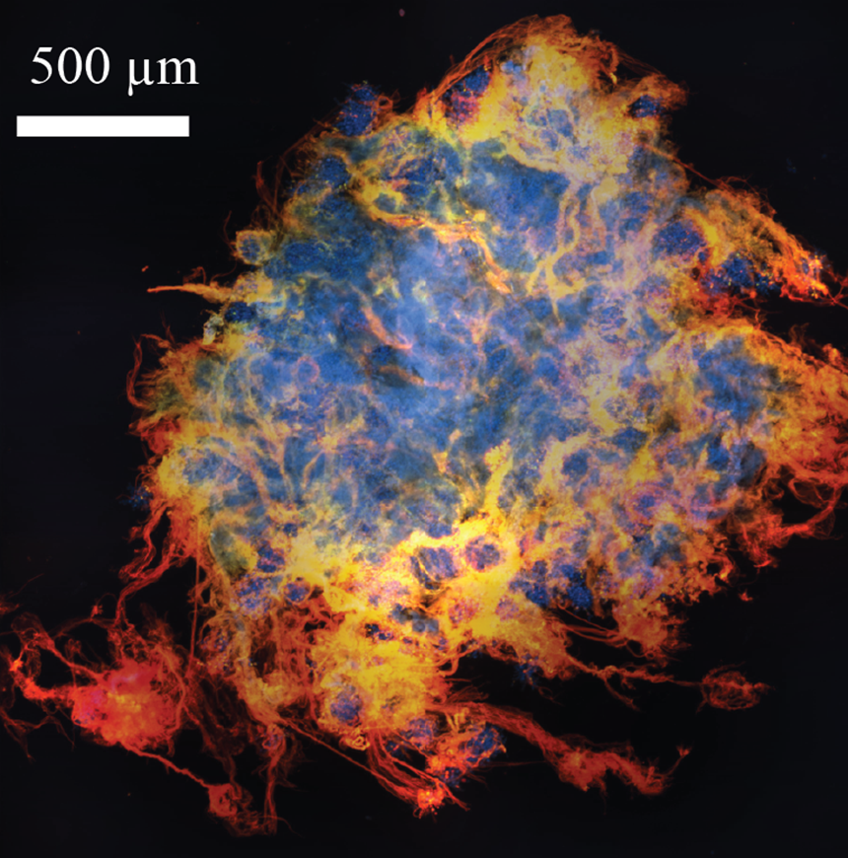
Novel form of cooperation
500 µm
Cells DNA Protein Protein +DNA

Slide 11
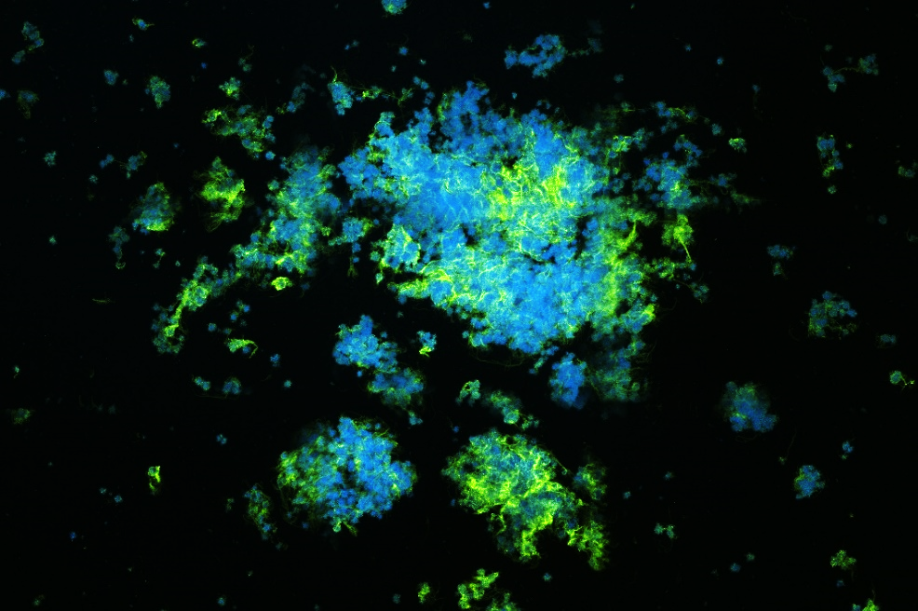
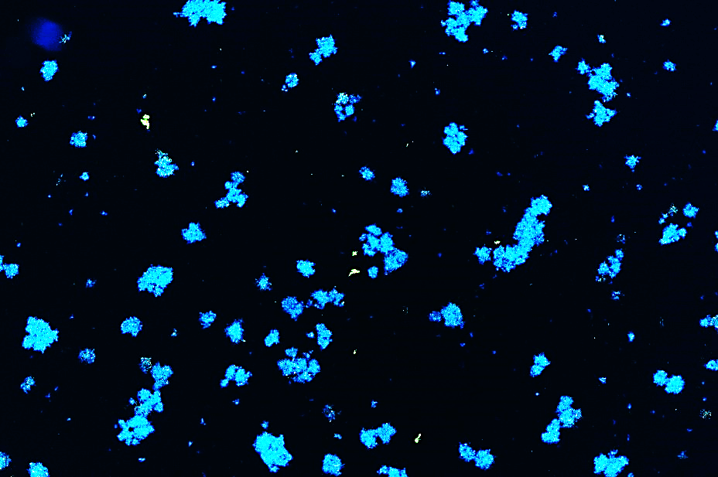
Proteins hold filaments together
500 µm
500 µm
Cells Protein

Slide 12
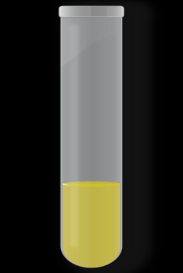
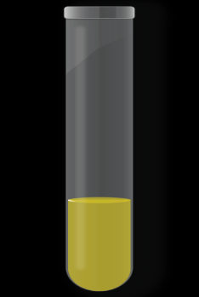
Are filaments adaptive?
x 5
Fast settling
x 5
Filamentation
segregates
with sex
~10,000 post-sex isolates
Slow settling

Slide 13
Filaments appear to be selected for
Chi-squared, p<<0.001

Slide 14
Filaments settle 8-fold faster
t-Test, t= 26.32, p=2.65E-12

Slide 15
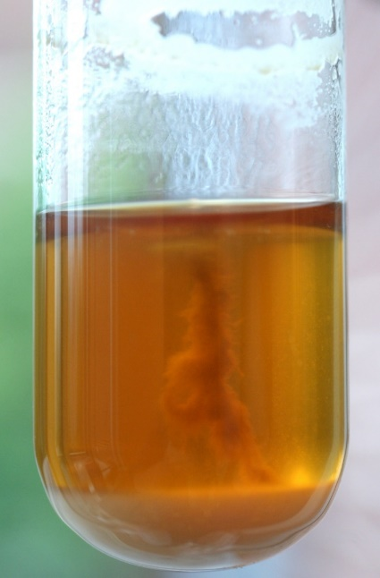
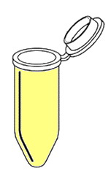
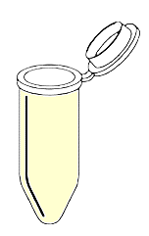
Determining filament survival
Top 90%
Compare amount of filament in top and bottom
Bottom 10%
Filaments
only
60 sec
settling selection
Filaments
only
Top 90%
Compare number of clusters in top and bottom
Bottom 10%
Clusters alone
Clusters alone

Slide 16
Lone clusters have low survival

Slide 17
Cooperative filaments have high survival

Slide 18
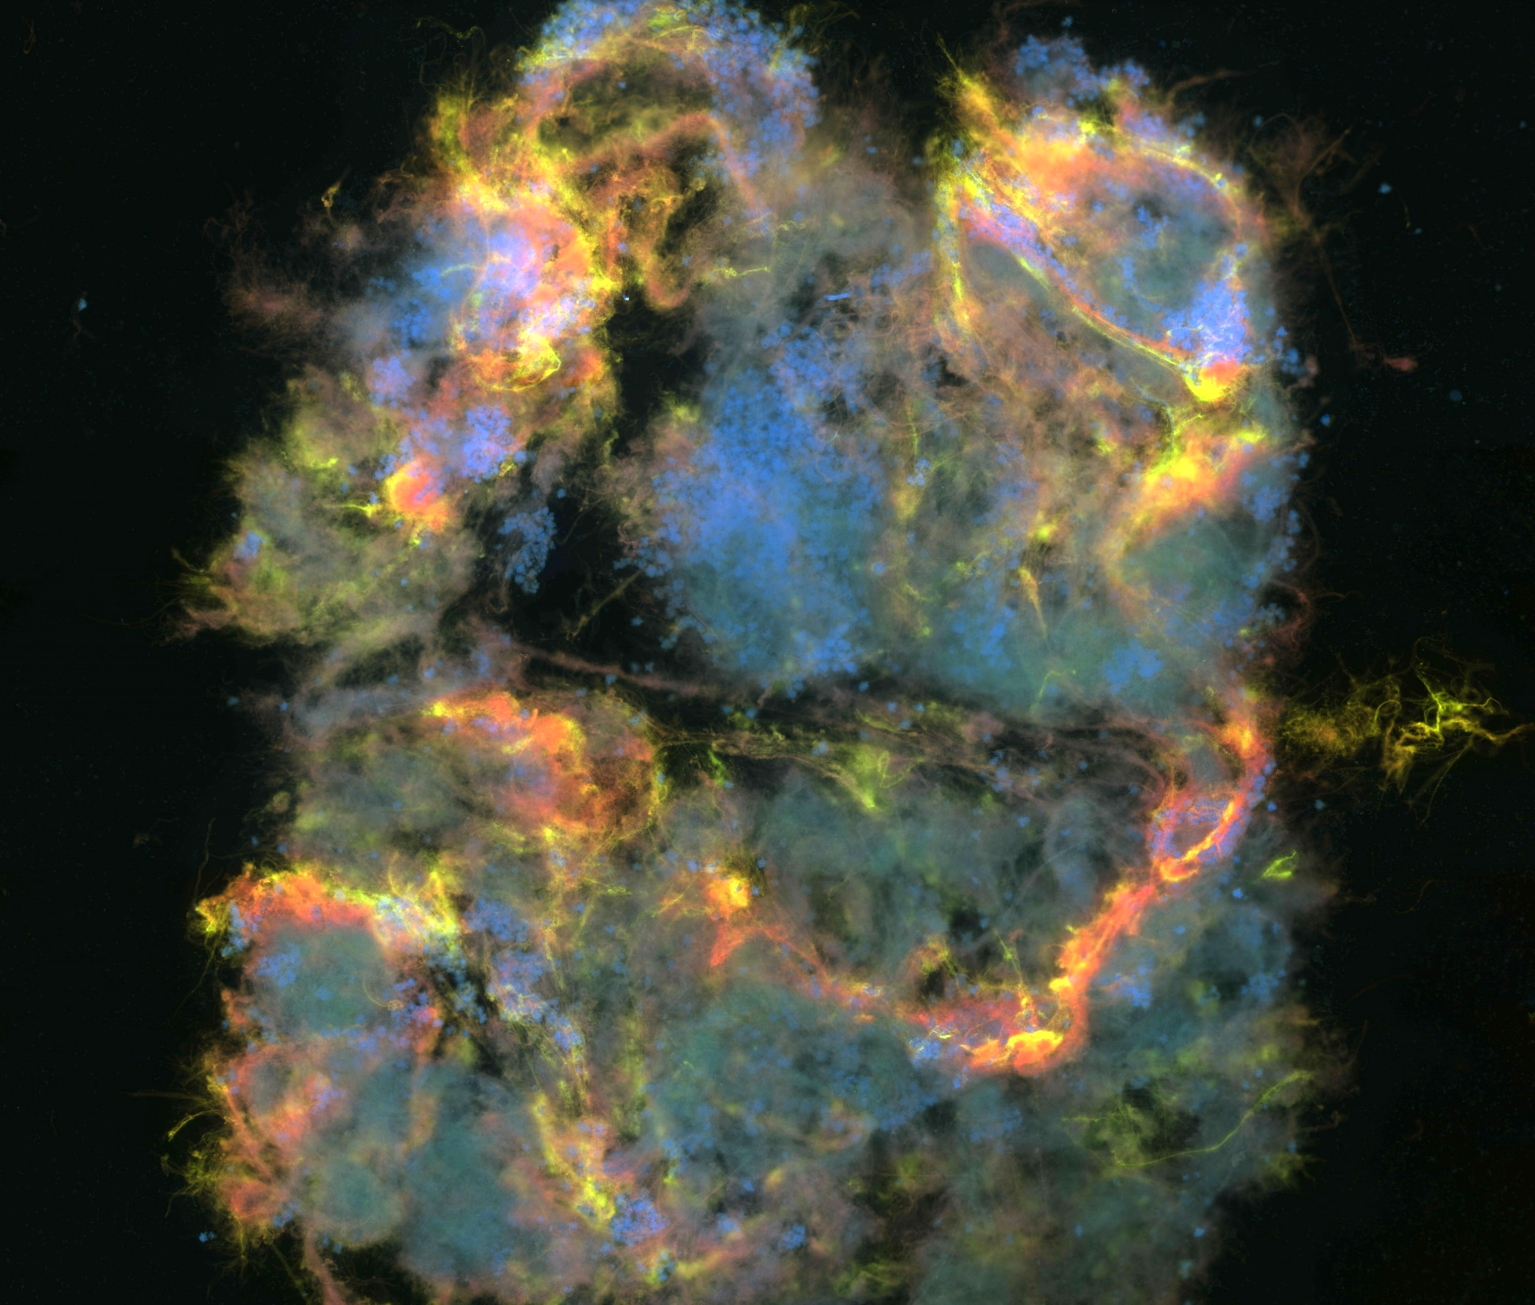
Cells
DNA
Protein
Protein +DNA
1000 µm

Slide 19
Filaments preferentially entangle clusters
Student’s t-test; t=2.854, p=0.0127

Slide 20
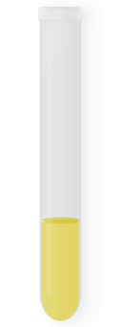
Is filamentation a public good?
0%
10%
20%
30%
40%
50%
Bulk population
Filaments
only
60%
70%
80%
90%
100%
Analyze to compare % filament - in the filaments vs. % filament - in the bulk population
filament formation
Filament +
Filament -

Slide 21
Filamentation is a public good
Pre-planned contrast of nested ANOVA; t=1.3, p=0.2

Slide 22
Conclusions
Hundreds of snowflake yeast clusters cooperate to form protein-based filaments
Filaments are adaptive
Filaments settle more quickly than clusters, and greatly increase survival
Filaments preferentially include clusters
Filamentation is a public good

Slide 23
Future Directions
Identify mechanism of filamentation (proteins and genes)
Find the effect of environmental conditions on the evolution of filamentation

Slide 24
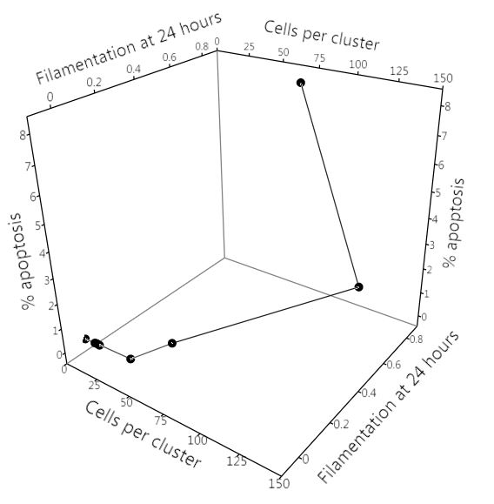
Filament lineage
Filament producing strain
Sexual reproduction
Day 225
Day 28

Slide 25
Future Directions
Identify mechanism of filamentation (proteins and genes)
Find the effect of environmental conditions on the evolution of filamentation

Slide 26
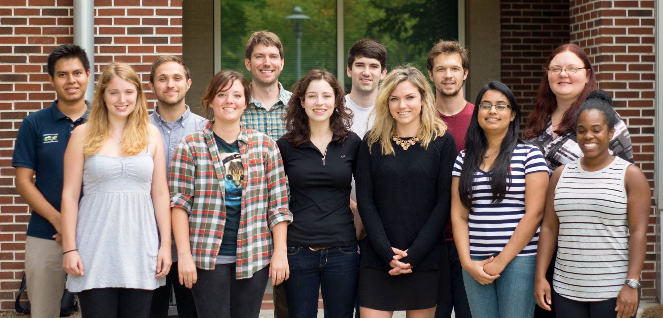
Thank you! Questions?
Peter Yunker
Shane Jacobeen
Ratcliff Lab
This material is based upon work supported by the National Science Foundation Graduate Research Fellowship under grant number DGE-1148903.

